Slide 1
This is a hidden slide
Dear honorable teacher please follow the instructions that has given in the slide notes (under the every slide). It would be helpful to take a successful class. Thanks a lot. I wish you good luck.

Slide 2
WELCOME
HOW ARE YOU ?

Slide 3
IDENTITY
SK.MD. HARUNAR RASHID.
Senior Teacher
Sonatola Model High School
Sonatola, Bogra.
Lesson
ENGLISH GRAMMAR.
Class : Nine & Ten
Unit : Three, Infinitives.

Slide 4
To
T : Do you know, ‘To’ What kind of parts of speech ?
S : To is a preposition.
T : OK

Slide 5
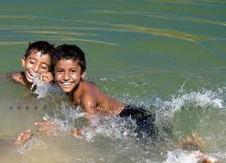
Read these sentences :
I want to go.
They like to swim.
To err is human.
In above sentences what are to go, to swim and To err ?
They are INFINITIVE

Slide 6
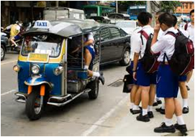
What is the structure of
Infinitive and Preposition ?
Infinitive =
to +
Present form of verb
As : I want to play.
Preposition =
to +
object.
As : They are going to school.

Slide 7
Lesson Declaration
So today we shall discuss about
Infinitives

Slide 8
Learning OUTCONES
After completing the lesson students will able to ..
learnt what Infinitive is.
learnt the uses of infinitive.
learnt finding out infinitive from a sentence.
learnt filling the gaps using infinitives.

Slide 9
Definition of Infinitive
The infinitive is the base of a verb, often preceded by to and never change according to person, number or tense.
Kinds of Infinitives :
There are two kinds of Infinitives
Infinitive
Simple or Noun Infinitive
Gerundial or Qualifying Infinitive

Slide 10
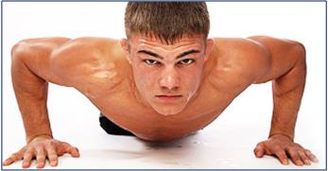
Definition of Simple or Noun Infinitive
When an infinitive does the function of a Noun, it is called Simple or Noun Infinitive.
As:
To take exercise is good for health.
Birds love to sing.
To respect our parents is our duty.

Slide 11
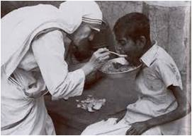
Simple or Noun Infinitive is used as :
Subject of a verb :
To err is human. To walk is good for health.
Object of a verb :
He likes to swim. I taught him to read.
c) Object of a Preposition :
He is about to die.
He is about to go.

Slide 12
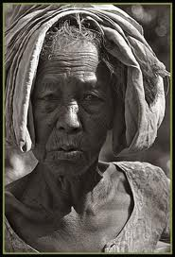
Simple or Noun Infinitive is used as :
d) Complement to verb :
He seems to be an honest man.
He appears to be a rich man.
e) Objective Complement :
We take him to be a fool.
She seems to be tired.
f) With too/enough.
He is too weak to walk
I have enough strength to face the reality.

Slide 13
Definition of Gerundial or Qualifying Infinitive.
When an infinitive qualify or Modify another parts of Speech or sentences, it is called Gerundial or qualifying Infinitive.
As:
I walked fast to avail the train.
To speak the truth, he is an honest man.

Slide 14
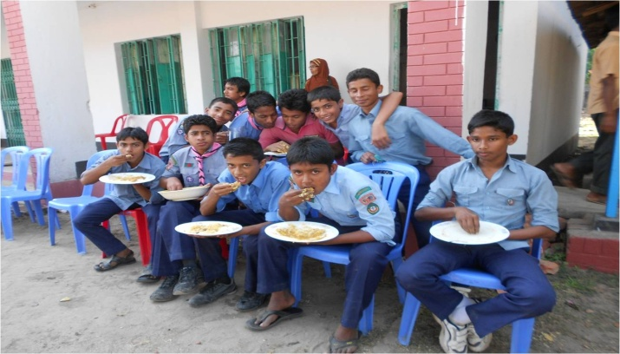
Gerundial or qualifying Infinitive is used to :
Modify an adjective :
The old man is too weak to walk.
I am glad to receive your letter.
He is ready to go.
b) Modify a verb :
The children went to play.
We eat to live.

Slide 15
Gerundial or qualifying Infinitive is used to :
c) Modify a noun :
It is a chair to sit on.
This is a house to let.
d) Modify an adverb :
We went to the field, to see to see the game.
I walked fast to avail the train.

Slide 16
Gerundial or qualifying Infinitive is used to :
e) Qualify a sentence :
To speak the truth, he is an
honest man.
To be brief, I am ruined.
Omissions of Infinitive
After certain verbs the infinitive is ommitted :
They are let, make, need, hear, watch, see, dare, watch, feel, had better, had rather, would rather, sooner than, rather than.

Slide 17
Perfect Infinitive
Perfect infinitive is formed by using ‘to have’ before a principal verb :
I wished to have gone there.
He seems to have seen better days.
They are reported to have done this.
Note : Perfect infinitive is used after past tense of verbs wish, desire, hope intend , command etc.

Slide 18
Split Infinitive
Split Infinitive : Some times adverb or adverb phrase is used in between infinitive and the verb in the sentence, in that case it is a split infinitive.
i) I request you to kindly help me.
ii) I request you to quickly do this.
The correct forms should be :
I request you to help me kindly.
I request you to do this quickly.

Slide 19
Individual Work
Open your English Grammar book page no. 18
Read the passage carefully :
Ask and answer with your partner :
Which sentence in the passage is without any infinitive ?
How many infinitives are there in sentence number three ? Which ‘to’ is not infinitive here ?
Which of the verbs in the passage have bare Infinitive ?

Slide 20
Pair Works
Open your English Grammar book page no. 18. Now read the passage again and pick out different kinds of infinitives.

Slide 21
Group Works
Fill in the gaps using infinitives where necessary :
a. The Headmaster advised me ……….. study regularly.
b. This is an easy chair ……….. sit on.
c. Munira is eager ………….. study engineering.
d. He need not ………….. do whatever he likes.
e. This is a house ………. let.
f. You had better ……………. go than stay here.
g. He seems ………….. be better today.
Answer : a) to b) to c) to d) x e) to f) x g) to.

Slide 22
HOME WORK
Write five sentences using infinitive ‘to’ and five sentences using preposition ‘to’.

Slide 23
Acknowledgement
We would like to express our cordial gratitude to the Ministry of Education, Directorate of Secondary & Higher Education, NCTB, a2i
and
the panel of honorable editors ( Md. Jahangir Hasan, Associate Professor (English) TTC, Rangpur, Ranjit Poddar, Associate Professor (English) TTC, Dhaka, and Urmila Ahmed, Associate Professor (English) TTC, Dhaka, to enrich the contents.

Slide 24
THE END.

